Slide 1

STP Preliminary Design Review
Ro Atre, Abdul Osilan, Meerav Shah, Connor Stapf

Slide 2
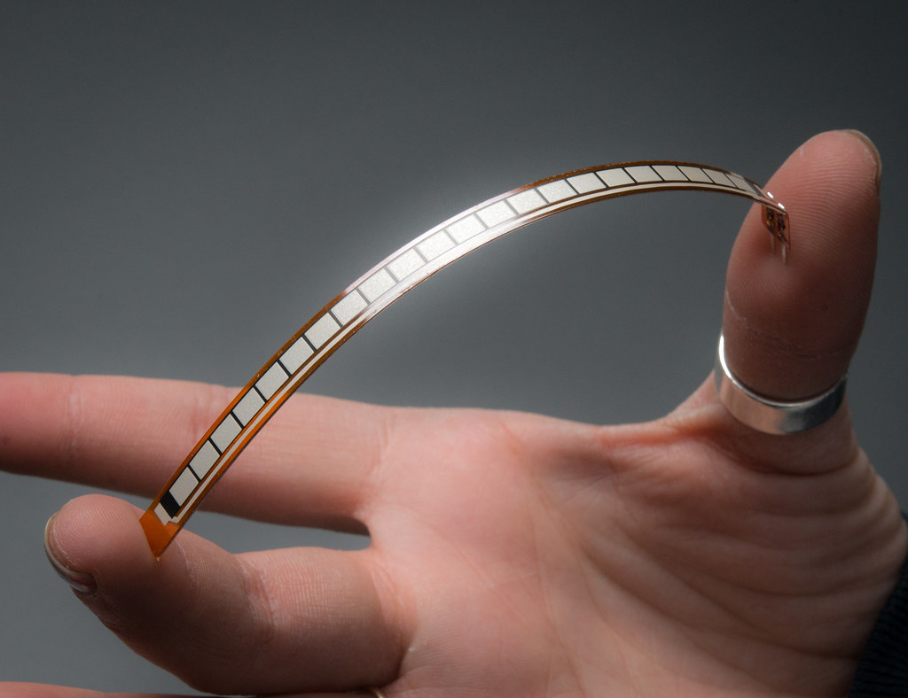
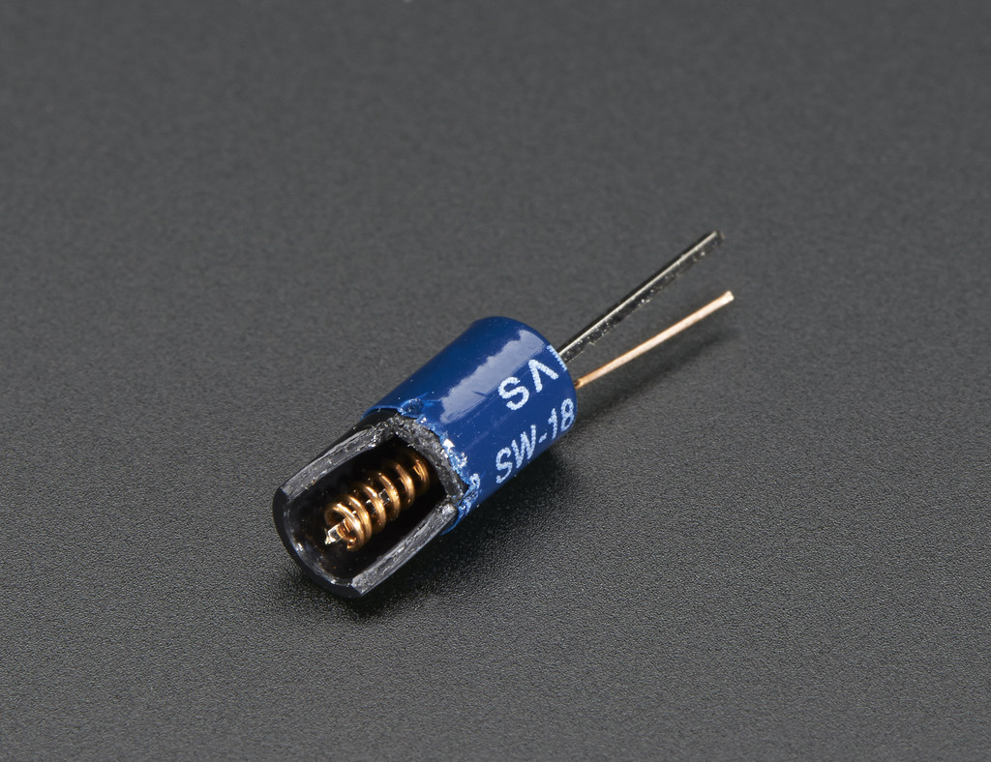
Scientific Mission
Flex Sensor
Measure structural stability of the rocket.
Measure vibrational stability of the rocket.
Analyze how the flex and vibrational forces change throughout the flight.
Determine applicability of rocket-propelled delivery of fragile items/components.
Vibration Sensor

Slide 3
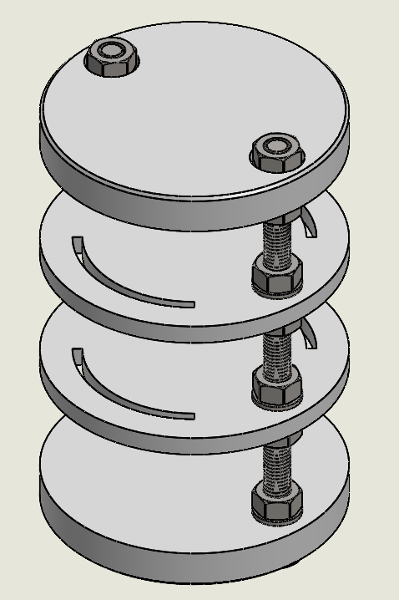
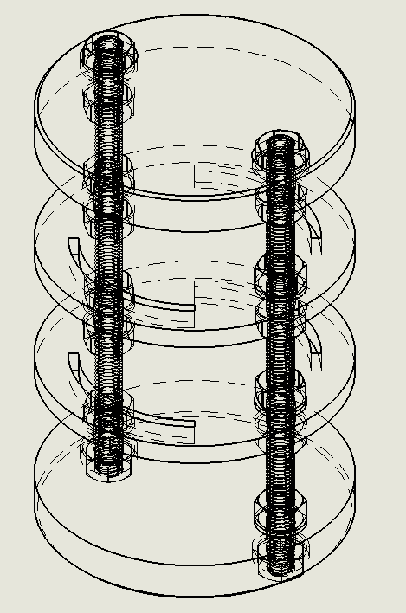
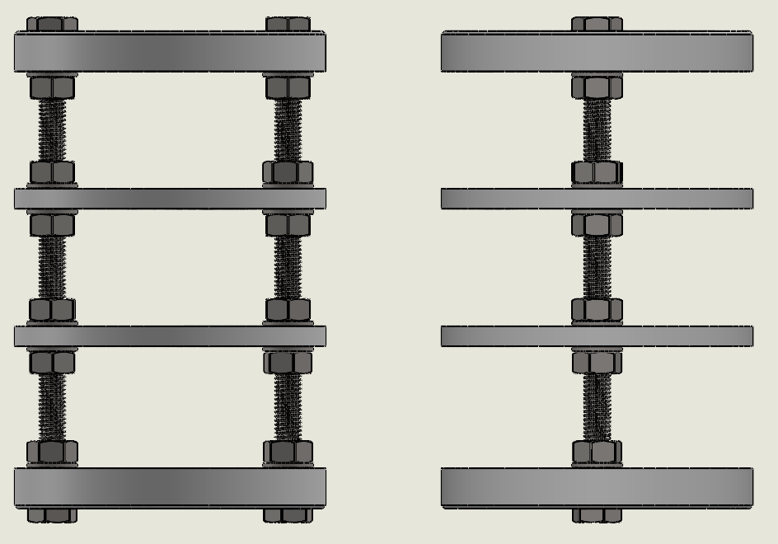
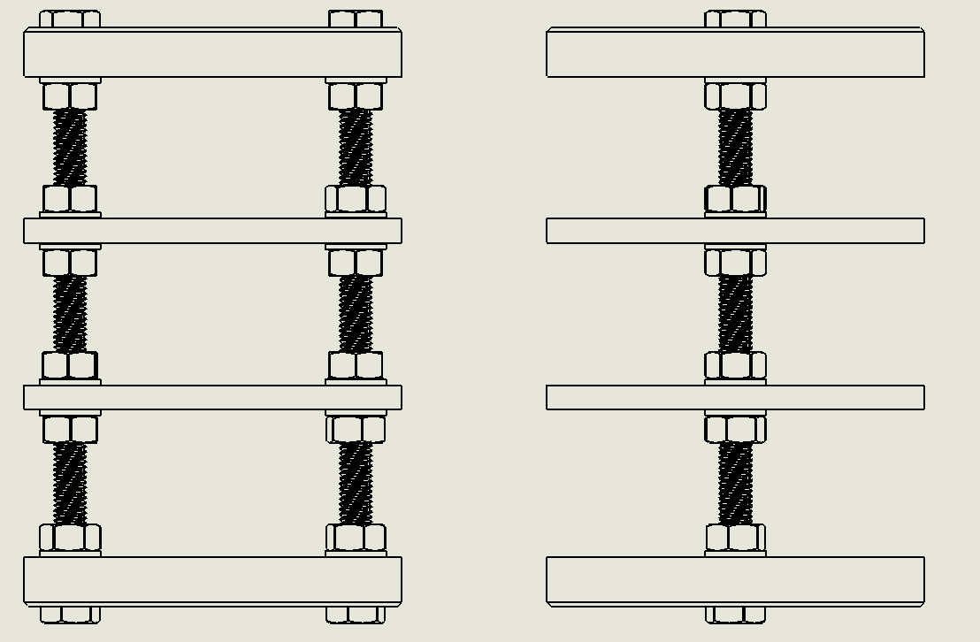
Payload Structure
Allows for additional or fewer platforms based on necessity.
With current setup, the structure mass is 79.31g.
All hardware is standardized metric-unit parts.
Slots for wire connections through platforms.

Slide 4

Fabrication Plan
Combination of 3D Printing and purchased hardware
Relatively quick and cheap part production
Standard hardware is easily sourceable from stores or distributors
PLA plastic provides stable, rigid platforms for electronics to be mounted
Electronic assembly to be completed on a platform-by-platform basis before being mounted onto the threaded rods of the main structure
Allows for easier testing before final construction
More platforms can be produced if more horizontal space is required

Slide 5
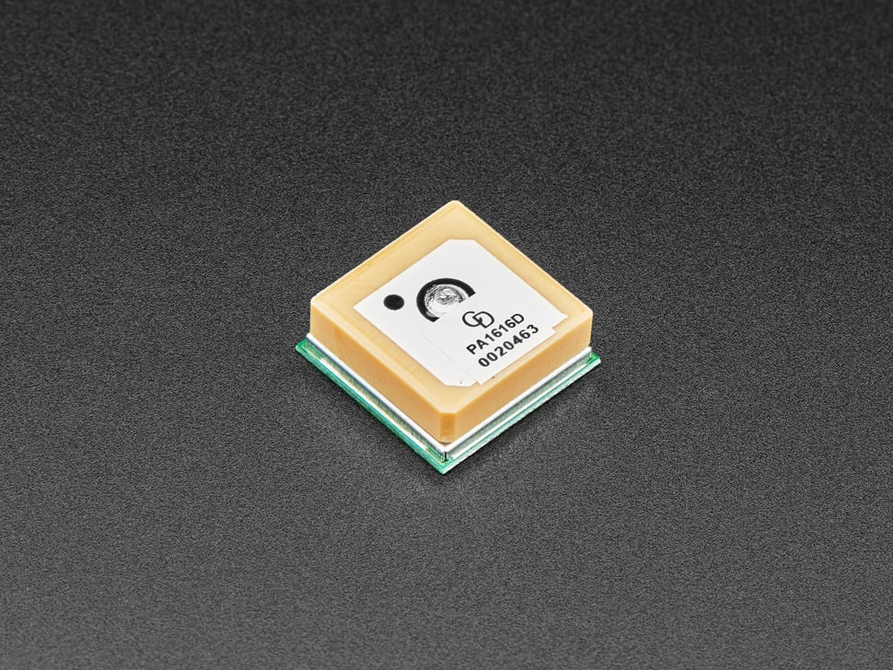
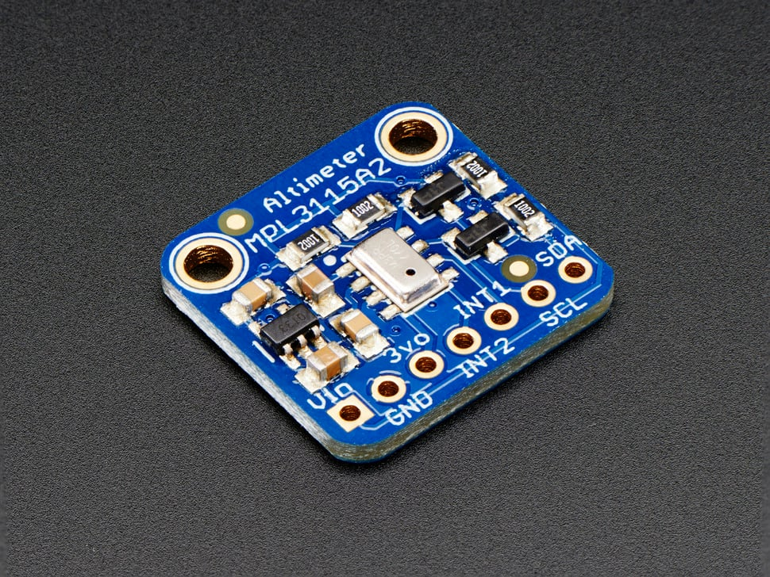
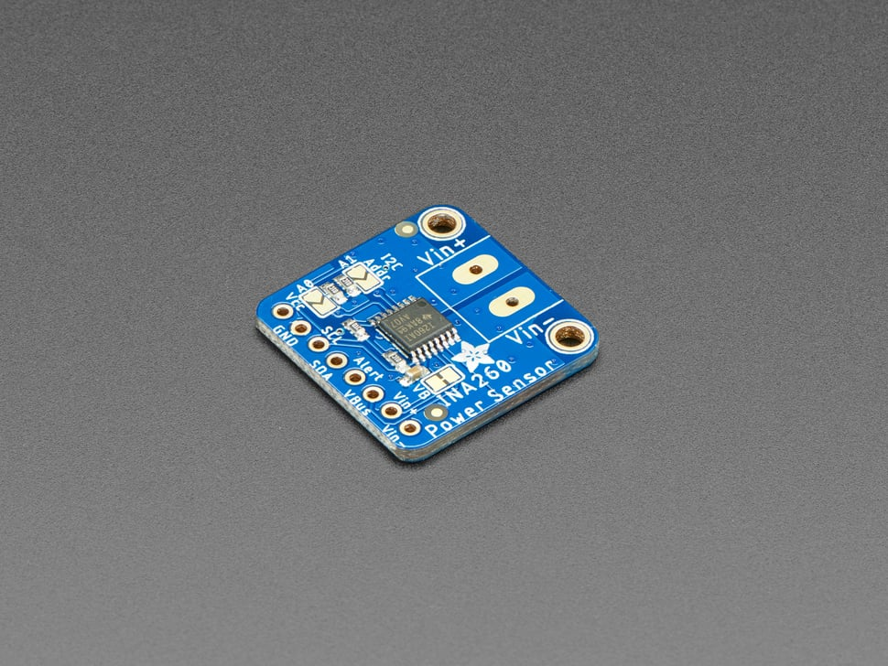
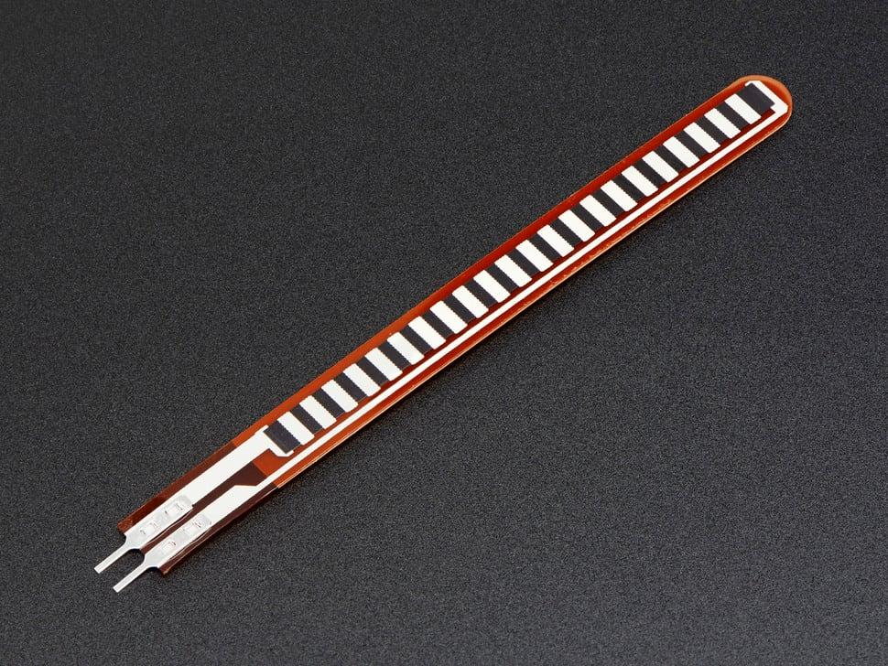
Primary Sensor Choice
GPS: Ultimate GPS Module PA1616D - 99 channel w/10 Hz updates - MTK3333 Chipset
Product ID: 5186
Barometer: MPL3115A2 - I2C Barometric Pressure/Altitude/Temperature Sensor
Product ID: 1893
Multimeter: Adafruit INA260 High or Low Side Voltage, Current, Power Sensor
Product ID: 4226
Flex Sensor: Short Flex Sensor
Product ID: 1070

Slide 6
Voltage Table
Component | Voltage
Microcontroller | 3.3V
GPS | 3.3V
Barometer | 2-3.6V
Multimeter | 3V or 5V
Flex Sensor | 3.3V or 5V
MicroSD Shield | 5V

Slide 7

Preliminary Parts List
SENSORS
Microcontroller (TBD)
GPS ($19.95, 5.7g)
Barometer ($9.95, 1.2g)
Multimeter ($9.95, 2.0g)
Flex Sensor ($7.95, 0.27g)
MicroSD Shield ($7.50)
Vibration Sensor ($0.95, 0.3g)
OTHER
MicroSD Card ($11.50)
Buzzer ($1.95, 0.7g)
Battery ($2, 1.9g)
Battery Charger (~$7)
Electrical Components (TBD)
Perf Board ($5)
Structure (Cost TBD, 79.31g)
Mounting Hardware (TBD)

Slide 8
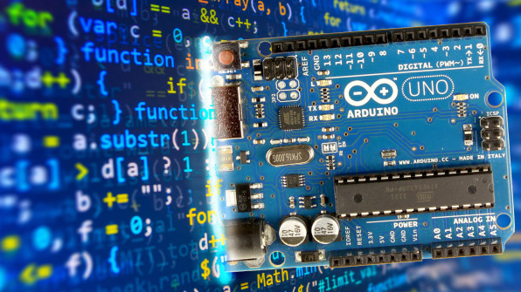
Programming Language & Microcontroller
PROGRAMMING LANGUAGE
Arduino
Cross Platform Compatibility
Convenient & Simple to fix
Help available if needed
Tons of libraries, C++ derivative, Active Community
Fits the scale of the project
Team has decided on this language
MICROCONTROLLER
Teensy 3.5 or 4.1
Powered by 9V Battery
Price range ~$25-35
42 I/O Points
Voltage Regulator Onboard
3 I2C, SPI, CAN and 8 Serial Ports.
Team will decide exact microcontroller

Slide 9
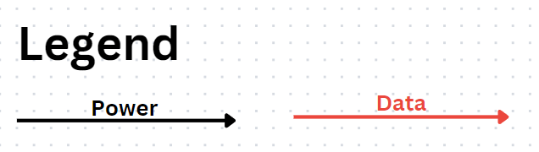
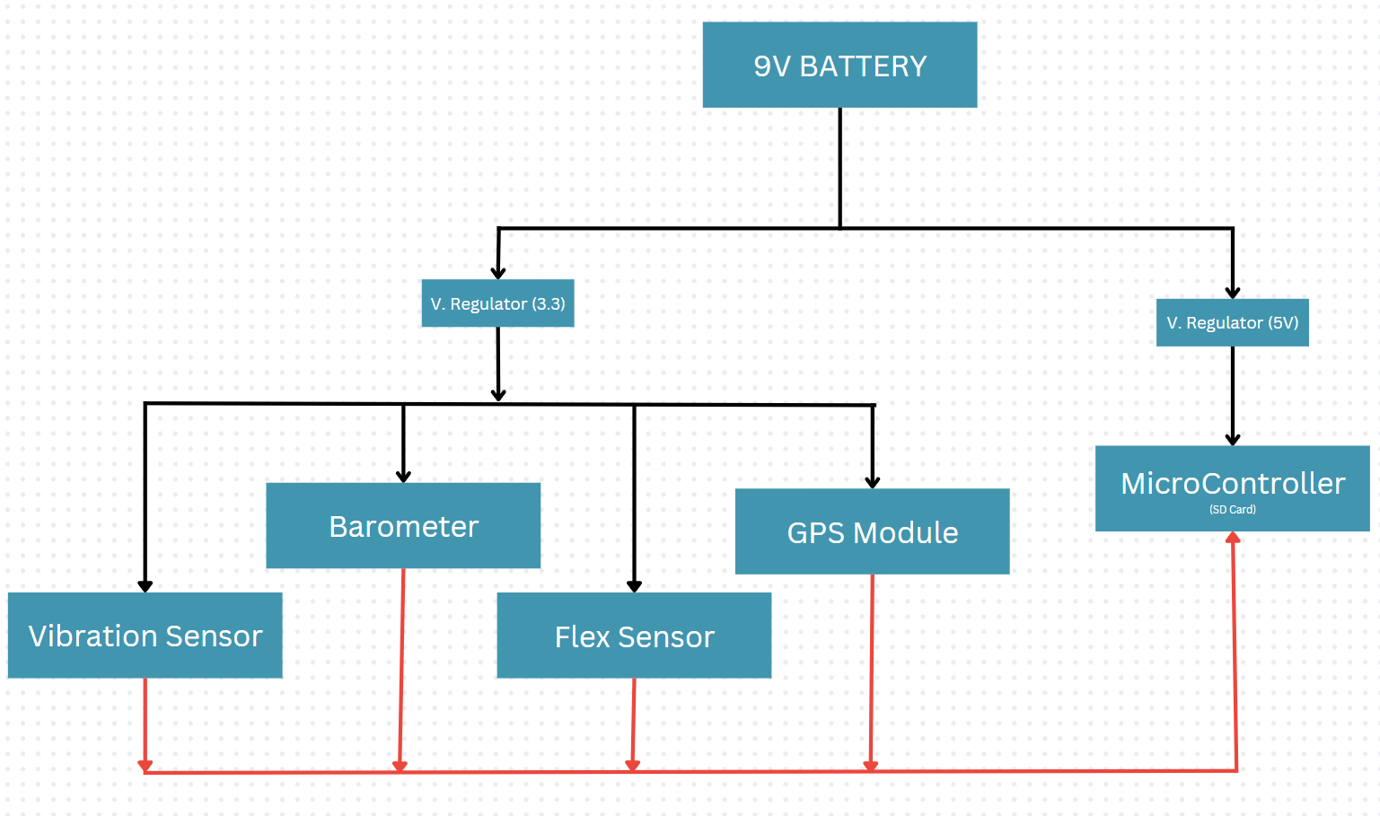
Systems Block Diagram

Slide 10
Cost & Mass Estimates
COST
Components | Cost
All sensors except microcontroller | $71.65
Most non-sensor electrical, controller and structural components | $49.50
Remaining in case of unexpected expenses | $28.85
MASS
Components | Mass
All sensors except microcontroller | 10.01g
Most non-sensor electrical, controller and structural components | 71.31g
Included for additional tolerance/error mass | 18.68g

Slide 11

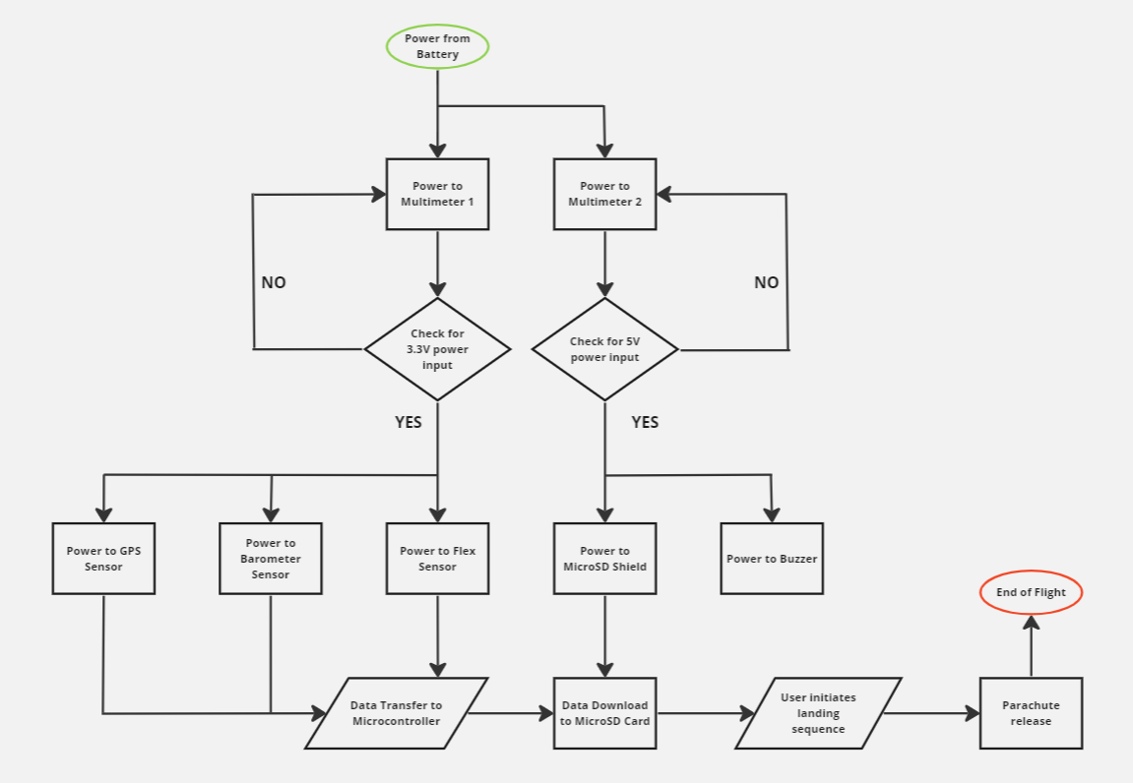
Con Ops

